Slide 1
Breadth-First Search

Slide 2
Agenda
Introduction
Real life example
Algorithm
Working
Complexity
Applications

Slide 3

Introduction
BFS is a traversing algorithm where you should start traversing from a selected node (source or starting node) and traverse the graph layer wise.
Explore the neighbor nodes (nodes which are directly connected to source node) then move towards the next-level neighbor nodes.

Slide 4
As the name BFS suggests, you are required to traverse the graph breadthwise as follows:
First move horizontally and visit all the nodes of the current layer
Move to the next layer
Often implemented by maintaining a queue of vertices to visit.

Slide 5
Real Life Example

Slide 6
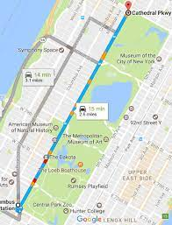
Navigation Systems: BFS can help find all the neighboring locations from the main or source location.

Slide 7
BFS Approach
Given any source vertex s, BFS visits the other vertices at increasing distances away from s. In doing so, BFS discovers paths from s to other vertices
What do we mean by “distance”? The number of edges on a path from s
Example
0
Consider s=vertex 1
8
2
Nodes at distance 1?
2, 3, 7, 9
1
2
s
9
1
1
Nodes at distance 2?
8, 6, 5, 4
7
1
3
6
2
4
1
5
Nodes at distance 3?
0
2
2

Slide 8
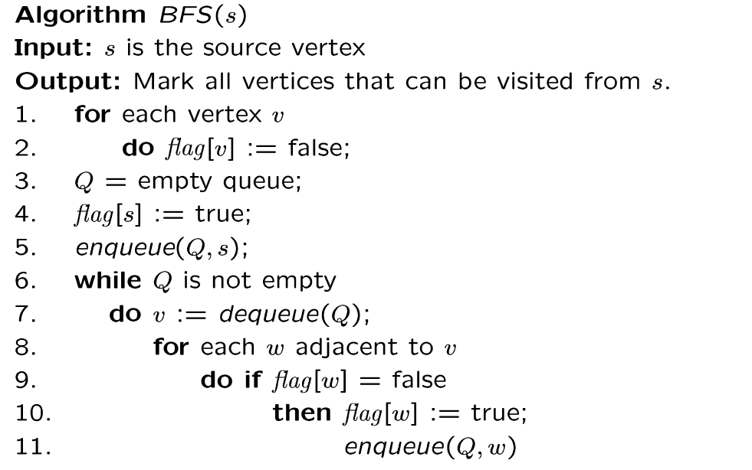
BFS Algorithm
// flag[ ]: visited table
Why use queue? Need FIFO

Slide 9
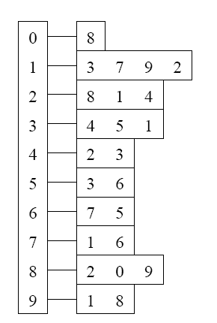
BFS Example
Adjacency List
Visited Table (T/F)
0
1
2
3
4
5
6
7
8
9
F
F
F
F
F
F
F
F
F
F
0
8
source
2
9
1
3
7
6
4
5
Initialize visited
table (all False)
Q =
{ }
Initialize Q to be empty

Slide 10
Adjacency List
Visited Table (T/F)
0
1
2
3
4
5
6
7
8
9
F
F
T
F
F
F
F
F
F
F
0
8
source
2
9
1
3
7
6
4
5
Flag that 2 has
been visited
Q =
{ 2 }
Place source 2 on the queue

Slide 11
Adjacency List
Visited Table (T/F)
0
1
2
3
4
5
6
7
8
9
F
T
T
F
T
F
F
F
T
F
0
8
Neighbors
source
2
9
1
3
7
6
4
5
Mark neighbors
as visited 1, 4, 8
Q =
{2} → { 8, 1, 4 }
Dequeue 2.
Place all unvisited neighbors of 2 on the queue

Slide 12
Adjacency List
Visited Table (T/F)
0
1
2
3
4
5
6
7
8
9
T
T
T
F
T
F
F
F
T
T
0
8
source
2
9
1
3
7
Neighbors
6
4
5
Mark new visited
Neighbors 0, 9
Q =
{ 8, 1, 4 } → { 1, 4, 0, 9 }
Dequeue 8.
-- Place all unvisited neighbors of 8 on the queue.
-- Notice that 2 is not placed on the queue again, it has been visited!

Slide 13
Adjacency List
Visited Table (T/F)
0
1
2
3
4
5
6
7
8
9
T
T
T
T
T
F
F
T
T
T
0
Neighbors
8
source
2
9
1
3
7
6
4
5
Mark new visited
Neighbors 3, 7
Q =
{ 1, 4, 0, 9 } → { 4, 0, 9, 3, 7 }
Dequeue 1.
-- Place all unvisited neighbors of 1 on the queue.
-- Only nodes 3 and 7 haven’t been visited yet.

Slide 14
Adjacency List
Visited Table (T/F)
0
1
2
3
4
5
6
7
8
9
T
T
T
T
T
F
F
T
T
T
0
8
source
2
9
Neighbors
1
3
7
6
4
5
Q =
{ 4, 0, 9, 3, 7 } → { 0, 9, 3, 7 }
Dequeue 4.
-- 4 has no unvisited neighbors!

Slide 15
Adjacency List
Visited Table (T/F)
Neighbors
0
1
2
3
4
5
6
7
8
9
T
T
T
T
T
F
F
T
T
T
0
8
source
2
9
1
3
7
6
4
5
Q =
{ 0, 9, 3, 7 } → { 9, 3, 7 }
Dequeue 0.
-- 0 has no unvisited neighbors!

Slide 16
Adjacency List
Visited Table (T/F)
0
1
2
3
4
5
6
7
8
9
T
T
T
T
T
F
F
T
T
T
0
8
source
2
9
1
3
7
6
4
5
Neighbors
Q =
{ 9, 3, 7 } → { 3, 7 }
Dequeue 9.
-- 9 has no unvisited neighbors!

Slide 17
Adjacency List
Visited Table (T/F)
0
1
2
3
4
5
6
7
8
9
T
T
T
T
T
T
F
T
T
T
0
8
Neighbors
source
2
9
1
3
7
6
4
5
Mark new visited
Vertex 5
Q =
{ 3, 7 } → { 7, 5 }
Dequeue 3.
-- place neighbor 5 on the queue.

Slide 18
Adjacency List
Visited Table (T/F)
0
1
2
3
4
5
6
7
8
9
T
T
T
T
T
T
T
T
T
T
0
8
source
2
9
1
7
Neighbors
3
6
4
5
Mark new visited
Vertex 6
Q =
{ 7, 5 } → { 5, 6 }
Dequeue 7.
-- place neighbor 6 on the queue

Slide 19
Adjacency List
Visited Table (T/F)
0
1
2
3
4
5
6
7
8
9
T
T
T
T
T
T
T
T
T
T
0
8
source
2
9
Neighbors
1
3
7
6
4
5
Q =
{ 5, 6} → { 6 }
Dequeue 5.
-- no unvisited neighbors of 5

Slide 20
Adjacency List
Visited Table (T/F)
0
1
2
3
4
5
6
7
8
9
T
T
T
T
T
T
T
T
T
T
0
8
source
2
9
1
Neighbors
3
7
6
4
5
Q =
{ 6 } → { }
Dequeue 6.
-- no unvisited neighbors of 6

Slide 21
Adjacency List
Visited Table (T/F)
0
1
2
3
4
5
6
7
8
9
T
T
T
T
T
T
T
T
T
T
0
8
source
2
9
1
3
7
6
4
5
What did we discover?
Look at “visited” tables.
There exists a path from source
vertex 2 to all vertices in the graph
Q =
{ }
STOP!!! Q is empty!!!

Slide 22
Time Complexity of BFS
(Using Adjacency List)
Assume adjacency list
  n = number of vertices m = number of edges
O(n + m)
Each vertex will enter Q
at most once.
Each iteration takes time proportional to deg(v) + 1 (the number 1 is to account for the case where deg(v) = 0 --- the work required is 1, not 0).

Slide 23
Running Time
Recall: Given a graph with m edges, what is the total degree?
The total running time of the while loop is:
this is summing over all the iterations in the while loop!
Σ_{vertex v} deg(v) = 2m
O( Σ_{vertex v} (deg(v) + 1) ) = O(n+m)

Slide 24
Time Complexity of BFS
(Using Adjacency Matrix)
Assume adjacency list
  n = number of vertices m = number of edges
O(n²)
Finding the adjacent vertices of v requires checking all elements in the row. This takes linear time O(n).
Summing over all the n iterations, the total running time is O(n²).
So, with adjacency matrix, BFS is O(n²) independent of the number of edges m.
With adjacent lists, BFS is O(n+m); if m=O(n²) like in a dense graph, O(n+m)=O(n²).

Slide 25
Applications
P2P Networks: BFS can be implemented to locate all the nearest or neighboring nodes in a peer to peer network. This will find the required data faster.
Web Crawlers: Search engines or web crawlers can easily build multiple levels of indexes by employing BFS. BFS implementation starts from the source, which is the web page, and then it visits all the links from that source.

